Slide 1
Day 1 - Module 2: Introduction to JUnit Framework and Its Usage in Selenium Script
Smita B Kumar

Slide 2
Day 1 - Agenda
Adding JUnit library in Java project
JUnit Annotations Used in Selenium scripts
JUnit Assertions
Exercise on Junit

Slide 3
Adding JUnit library in Java project
Basically JUnit is an open source unit testing tool and used to test small/large units of code. To run the JUnit test you don’t have to create class object or define main method.
JUnit provide assertion library which is used to evaluate the test result. Annotations of JUnit are used to run the test method. JUnit is also used to run the Automation suite having multiple test cases.

Slide 4
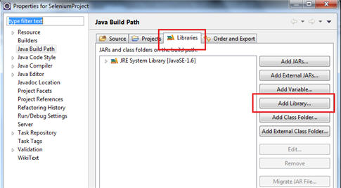
Adding JUnit library in Java project
First we will learn how to add JUnit library in your Java project:
Step #1: Right click on Java project->Build Path->Configure Build path
Step #2: Click Libraries->Add Library

Slide 5
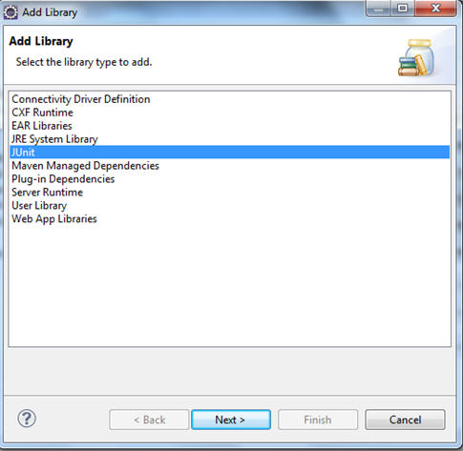
Adding JUnit library in Java project
Step #3: Click on Junit.

Slide 6
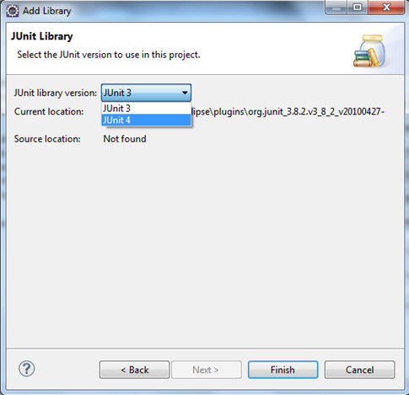
Adding JUnit library in Java project
Step #4: Select Junit4->Finish

Slide 7
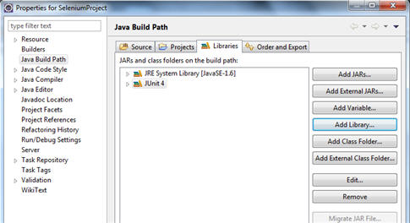
Adding JUnit library in Java project
Step #5: Click OK.

Slide 8
JUnit Annotations Used in Selenium scripts
There are many frameworks like Data Driven Framework, Keyword Driven Framework, and Hybrid Framework which use Junit tool as test runner and which will help to start the batch execution and reporting.
JUnit Annotations Used in Selenium scripts
There are many annotations available in Junit. Here we have described few annotations which are used very frequently in Selenium scripts and framework.
How to Run a Junit test:
Navigate to run ->Run as Junit test
#1. @Test
@Test annotation is used to run a Junit test.
Example:
1 @Test
2 public void junitTest()
3 {
4 System.out.println("Running Junit test");
5 Assert.assertEquals(1,1);
6 }

Slide 9
JUnit Annotations Used in Selenium scripts
#2. @Before:
@Before annotation is used to run any specific test before each test.
1 public class Junttest {
2 @Before
3 public void beforeTest(){
4 System.out.println("Running before test");
5 }
6
7 @Test
8 public void junitTest(){
9 System.out.println("Running Junit test");
10 }
11 }
Output: Running before test Running Junit test
Example of before annotation using two junit test method.

Slide 10
JUnit Annotations Used in Selenium scripts
1 public class Junttest {
2 @Before
3 public void beforeTest(){
4 System.out.println("Running before test");
5 }
6
7 @Test
8 public void junitTest(){
9 System.out.println("Running Junit test");
10 }
11
12 @Test
13 public void secondJunitTest(){
14 System.out.println("Running second Junit test");
15 }
16 }
Output: Running before test Running Junit test Running before test Running second Junit test
Before running junitTest method beforeTest method will run. Similarly before running secondJuntiTest again beforeTest method will run and produces output like above.

Slide 11
JUnit Annotations Used in Selenium scripts
1 public class Junttest {
2 @BeforeClass
3 public static void beforeClassTest(){
4 System.out.println("Executed before class method");
5 }
6 @Test
7 public void junitTest(){
8 System.out.println("Running Junit test");
9 }
10 @Test
11 public void secondJunitTest(){
12 System.out.println("Running second Junit test");
13 }
14 }
Output:
Executed before class method
Running Junit test Running second Junit test
#3. @BeforeClass
This method executes once before running all test. The method has to be a static method. Initialization of properties files, databases etc are done in beforeClass method.

Slide 12
JUnit Annotations Used in Selenium scripts
#4. @After
This method executes after each test.
1 public class Junttest {
2 @Test
3 public void junitTest(){
4 System.out.println("Running Junit test");
5 }
6
7 @After
8 public void afterTest(){
9 System.out.println("Running after method");
10 }
11 }
Output:
Running Junit test
Running after method

Slide 13
JUnit Annotations Used in Selenium scripts
#5. @AfterClass
Like @BeforeClass, @AfterClass executes once after executing all test methods. Like @BeforeClass method, @AfterClass method has to be a static method.
1 public class Junttest {
2
3 @Test
4 public void junitTest(){
5 System.out.println("Running Junit test");
6 }
7
8 @Test
9 public void secondJunitTest(){
10 System.out.println("Running second Junit test");
11 }
12
13 @AfterClass
14 Public static void afterClassTest(){
15 System.out.println("Running afterclass method");
16 }
17 }
Output:
Running Junit test
Running second Junit test
Running afterclass method
Junit assertions are used to validate certain condition and stops execution of program if the conditions are not satisfied.

Slide 14

JUnit Annotations Used in Selenium scripts
#6. Parameterized Junit class:
Parameterized class is used to run same scenario with multiple dataset.
Below is the example to pass multiple parameters in a Junit test.
@Parameters annotation tag is used to pass multiple data. Here, we have taken 2*2 dimensional array and the data can be visualized like below:

Slide 15
JUnit Annotations Used in Selenium scripts
1 @RunWith(Parameterized.class)
2 public class Junttest {
3 public String name;
4 public int age;
5 public Junttest(String name,int age){
6 this.name=name;
7 this.age=age;
8 }
9
10 @Test
11 public void testMethod(){
12 System.out.println("Name is: "+name +" and age is: "+age);
13 }
14
15 @Parameters
16 public static Collection<Object[]> parameter(){
17 Object[][] pData=new Object[2][2];
18 pData[0][0]="Tom";
19 pData[0][1]=30;
20 pData[1][0]="Harry";
21 pData[1][1]=40;
22 return Arrays.asList(pData);
23 }
24 }

Slide 16
JUnit Assertions
JUnit assertEquals: This checks if the two values are equal and assertion fails if both values are not equal.
This compares Boolean, int, String, float, long, char etc.
Syntax: Assert.assertEqual(“excepted value”, ”actual value”);
Example: Assert.assertEqual(“ABC”,”ABC”); //Both the strings are equal and assertion will pass. Assert.assertEqual(“ABC”,”DEF”); //Assertion will fail as both the strings are not equal. Assert.assertEqual(“Strings are not equal”, “ABC”,”DEF”); //message will be thrown if equal condition is not satisfied.

Slide 17
JUnit Assertions
Below is the example of use of JUnit assertion in selenium:
In above example assertion will fail as both the strings are not equal. One is text of username field and other is the text of password field.
1 String username=driver.findElement(By.id(“username”)).getText();
2 String password=driver.findElement(By.id(“password”)).getText();
3 Assert.assertEqual(“Mismatch in both the string”, username, password);

Slide 18
JUnit Assertions
JUnit assertTrue: Returns true if the condition is true and assertion fails if the condition is false. Assert.assertTrue(“message”, condition); Assert.assertTrue(“Both the strings are not equal”, (“HelloWorld”).equals(“HelloWorld”));
Here assertion will pass as both the strings match. It will print message if the assertion fails.
JUnit assertFalse: Returns true if the condition is false and assertion fails if the condition is true. Assert.assertFalse(“message”, condition); Assert.assertFalse(“Both the strings are equal”, (“Hello”).equals(“HelloWorld”));
There will not be any assertion error as the condition is false.

Slide 19
Conclusion
Most of the programmers use Junit as it is easy and does not take much effort to test. A simple green or red bar will show the actual result of the test. Junit makes life easy as it has its own set of libraries and annotations. Here we have also described commonly used annotations used with selenium scripts and framework.
More detail about framework and use of Junit annotations will be discussed in upcoming tutorial which is dedicated exclusively for framework design using Junit. This tutorial will help us in designing the framework using Junit.

